Slide 1

E-COMMERCE CAPSTONE PROJECT
SATADHRITI CHAKRABARTY
DS C17 Group 2

Slide 2
PROBLEM STATEMENT- Dipping Revenues & Customer Churn
Our company, Eleckart, has been facing dipping revenues in recent times despite spending heavily on marketing and promotions
Customer churn is turning up to be a big problem for us and we need to tackle it as soon as possible to know where we are going wrong

Slide 3
OBJECTIVE- Optimizing Advertisement & Marketing Spends and Understanding the KPI’s
Create a market mix model for the three product sub-categories viz. Camera Accessory, Gaming Accessory and Home Audio to determine the effectiveness of various marketing campaigns and promotional spends and the KPI’s that need to be taken care of while listing our products on our website
Infuse trust in our customers who have been clearly dissatisfied of late by analyzing what has gone wrong in the recent past
Establish the brand value of our company amongst the industry leaders and maximizing revenue and profit by optimizing the marketing and advertisement spends and understanding the effect of the KPI’s in determining the revenue

Slide 4
DATA UNDERSTANDING- 4 P’s of Marketing
We have data regarding the product, price, place and promotion. To classify them broadly under each segment:
Product- Order_ID, Order_Item_ID, Units, SLA, Product Procurement SLA, product_analytic_category, product_analytics_supercategory, product_analytic_vertical
Price- GMV, Product MRP, Stock Index
Promotion- Advertising Spends, Monthly Net Promoter Score
Place- Pin code, Climate Data

Slide 5
VARIABLE CREATION- Deriving New KPI’s
List Price: GMV/No. of Units
Discount Rate:
Product MRP-List Price
Product MRP
Order Value:
Units/Product MRP
100
Holiday:
If in list of holidays, then flag =1
Premium Product:
MRP is more than 90 percentile
Pay Day:
Day 1 or Day 15, Then Pay_Day=1
Moving Averages:
3 & 5 weeks MA created for media channels, NPS, Stock Index, discount
Adstocks:
Created for all media investments, taking adstock rate as 0.5
Lag Variables:
Lags of 1,2,3 weeks created for all variables

Slide 6
DATA CLEANING AND PREPARATION
A brief on how the data was cleaned and prepared for analysis:
Week extracted from the Date column for all the data
Binary and Dummy encoding for the categorical variables
Treating missing values with relevant values like mean in case of climatic variables
Irrelevant columns were removed
Order_ID and Order_Item_ID duplicity was dealt with
Outlier treatment for continuous variables
Entire data was aggregated at a weekly level to carry out the analysis for 52 weeks ranging from July 1st,2015 to June 30th, 2016

Slide 7
EXPLORATORY DATA ANALYSIS
EDA was carried out to check the distribution of feature variables. relation between variables and checking the correlation for the continuous variables

Slide 8
EDA- Univariate Analysis Part 1
Not going into the details of the plots for univariate analysis, we have highlighted a few key takeaways here:
GMV of most products are in the range $300 - $400
Majority of people buy 1 unit at a time
Most products take around 5-6 days to get delivered to the customers
Most of the products have an MRP of around $1000

Slide 9
EDA- Univariate Analysis Part 2
A few additional points on univariate EDA:
Time taken to procure most products is 2 days
List price is mostly in the range of $300 - $400
Discounts are in the range of $50 - $60
Order value of the products are mostly around $1000, same as MRP as majority people buy only 1 unit at a time

Slide 10
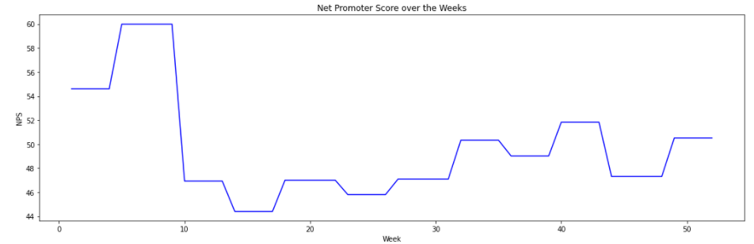
EDA- NPS is very low around 15th-20th week though it achieves a healthy score in and around the 40th week(month of April-May)

Slide 11
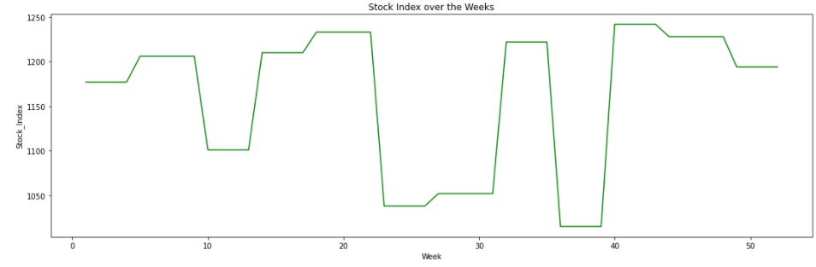
EDA- Stock Index is the highest around the 20th week (November) and the 40th week (April-May)

Slide 12
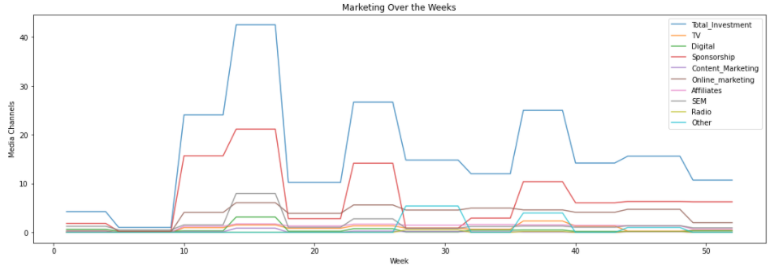
EDA- Marketing for almost all the items has been the highest in and around the 15th-20th week and again around 35th-40th week

Slide 13
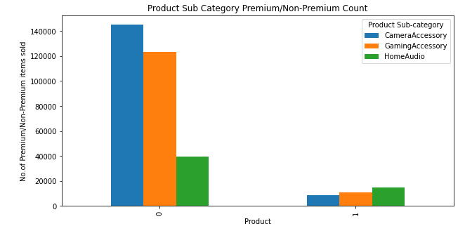
Bivariate & Multivariate EDA- Home Audio has very high number of items sold in the premium category

Slide 14
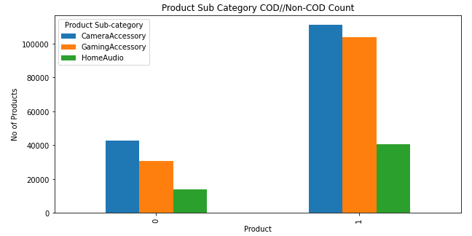
Bivariate & Multivariate EDA- All the three product sub-categories sold are mainly Cash on Delivery

Slide 15
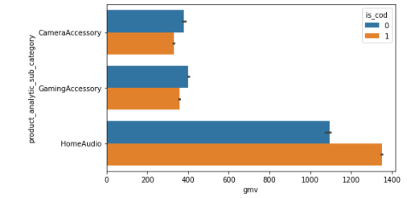
Bivariate & Multivariate EDA- Revenue(median) for prepaid products is higher for Camera and Gaming Accessories while for Home Audio, revenue(median) for COD is higher

Slide 16
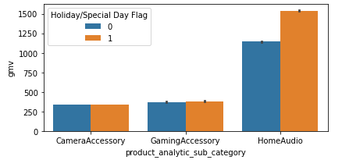
Bivariate & Multivariate EDA- Revenue of Home Audio products is much higher on holidays than Camera and Gaming products

Slide 17
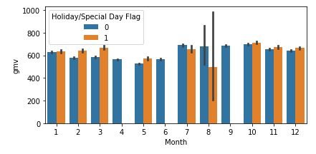
Bivariate & Multivariate EDA- Revenue on holidays or special days is the highest in the period of October-December which is a festive season in Canada, starting from THANKSGIVING to CHRISTMAS

Slide 18
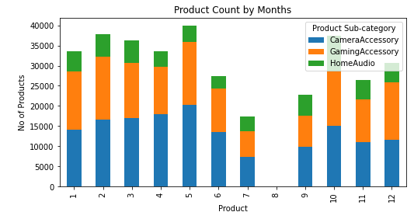
Bivariate & Multivariate EDA- May and October have the highest sales in terms of volume

Slide 19
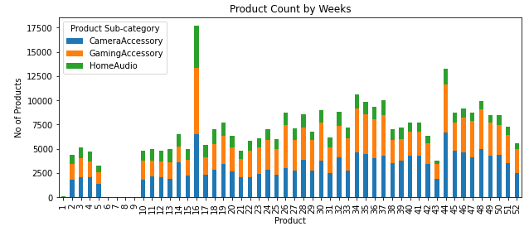
Bivariate & Multivariate EDA- Sales in 16th week (in October) is the highest followed by the last week in April, which is due to the marketing spends that happened just before, accompanied by high NPS and stock values

Slide 20
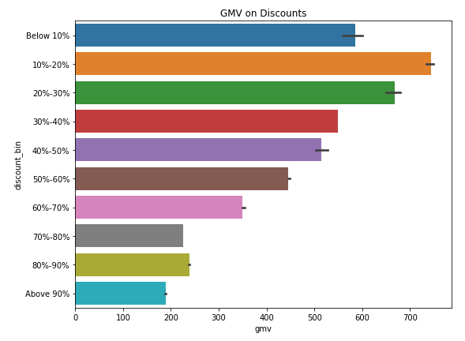
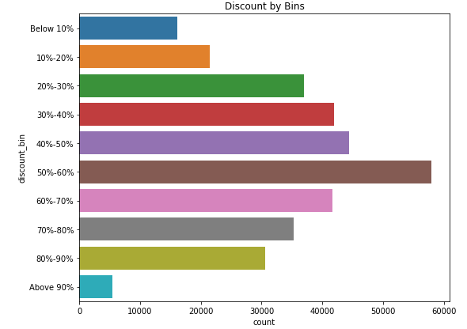
Bivariate & Multivariate EDA- Highest revenue is generated when the discount is between 10%-20% and falls down gradually with higher discounts though it is being observed that maximum discounts are provided in the range of 50%-60%

Slide 21
MODEL BUILDING & EVALUATION
We have built several models to find the right model for our product sub-categories
We have taken only those variables which are significant with respect to their p-values and acceptable Variable Inflation Factor (VIF) and have taken their coefficients to model their importance on the revenue

Slide 22
STATISTICAL MODELS
We have merged our main data with climate, media investment and customer satisfaction data.
We have taken moving averages of some of the important variables and grouped the data weekly for the year in concern.
Our dependent variable being GMV, we have built several linear models for checking the one that fits our data best:
Additive Model
Multiplicative Model
Koyck Model
Distributive Lag Additive Model
Distributive Lag Multiplicative Model
Not going into the details of all the models, we will talk only about the best models in terms of performance. The two best models are:
Multiplicative Model and Distributive Lag Multiplicative Model
The best performance by these models suggest that there is an interaction effect amongst the variables which is quite natural because most of our variables are somewhat interrelated.

Slide 23
COMBINING THE TWO MULTIPLICATIVE MODELS
Captures the interaction effect amongst variables

Slide 24
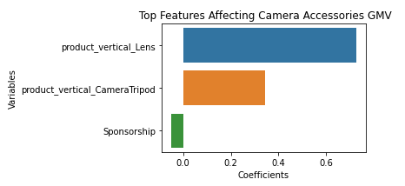
CAMERA ACCESSORIES- Top Features (Multiplicative)
Equation of the best fitted line:
GMV = -0.028 + 0.726 product_vertical_Lens + 0.344 product_vertical_CameraTripod
- 0.051 Sponsorship

Slide 25
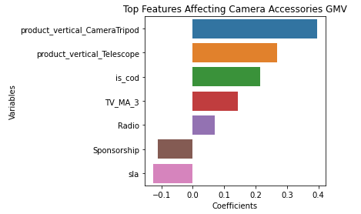
CAMERA ACCESSORIES- Top Features (Distributive Lag Multiplicative)
Equation of the best fitted line:
GMV = 0.06 + 0.396 product_vertical_CameraTripod + 0.269 product_vertical_Telescope + 0.214 is_cod + 0.144 TV_MA_3 + 0.07 Radio - 0.112 Sponsorship - 0.127 sla

Slide 26
Derivations from Camera Accessories
Lens, Camera Tripod and Telescope are the highest revenue-generating verticals
Cash-on-Delivery has a positive impact on gmv
Advertisements on TV and Radio have positive effect on revenue but Sponsorship has a negative impact
The more the time taken to deliver a product, the more the revenue is affected

Slide 27
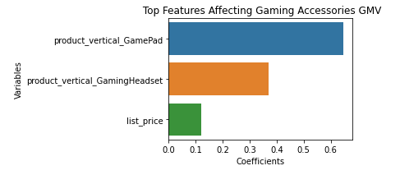
GAMING ACCESSORIES- Top Features (Multiplicative)
Equation of the best fitted line:
GMV =
-0.014 + 0.647 product_vertical_GamePad + 0.371 product_vertical_GamingHeadset + 0.12 list_price

Slide 28
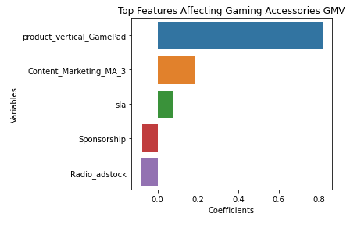
GAMING ACCESSORIES- Top Features (Distributive Lag Multiplicative)
Equation of the best fitted line:
GMV = -0.004 + 0.817 product_vertical_GamePad + 0.182 Content_Marketing_MA_3 + 0.079 sla - 0.076 Sponsorship - 0.083 Radio_adstock

Slide 29
Derivations from Gaming Accessories
Game Pad and Gaming Headset are the biggest revenue-generating products
Higher list price has a positive relation with gmv which is not so surprising due to the fact that gaming accessories are mostly bought by the younger generation who has this innate nature to perceive a higher priced product as a better product
Money spent on Content Marketing has a positive effect on the revenue but sponsorship spends as
well as radio adstock contribute negatively, which signifies the fact that content is a key factor for
impacting the young minds while they are not so much interested about the sponsorships and hardly
listen to the radio

Slide 30
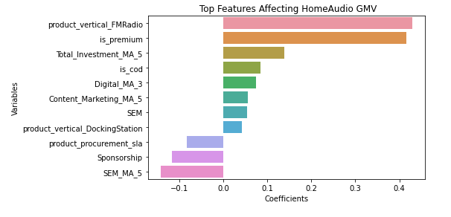
HOME AUDIO- Top Features (Multiplicative)
Equation of the best fitted line:
GMV = -0.016
+ 0.429 product_vertical_FMRadio + 0.416 is_premium + 0.139 Total_Investment + 0.085 is_cod + 0.075 Digital_MA_3 + 0.056 Content_Marketing_MA_5 + 0.054 SEM + 0.043 product_vertical_DockingStation - 0.083 product_procurement_sla - 0.117 Sponsorship - 0.142 SEM_MA_5

Slide 31
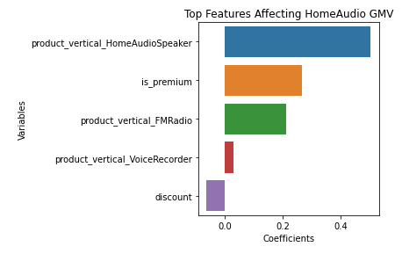
HOME AUDIO- Top Features (Distributive Lag Multiplicative)
Equation of the best fitted line:
GMV = -0.002 + 0.504 product_vertical_HomeAudioSpeaker + 0.268 is_premium + 0.212 product_vertical_FMRadio + 0.03 product_vertical_VoiceRecorder - 0.062 discount

Slide 32
Derivations from Home Audio
FM Radio, Home Audio Speaker and Voice Recorder generate the highest revenues
5 weeks average of Total Investment has a positive impact on revenues i.e. investment should be done for a consistent period of time to reap the benefits
Cash-on-Delivery has a positive impact on the gmv

Slide 33
Derivations from Home Audio
3 weeks average of Digital media and 5 weeks average of Content Marketing spends impact revenue positively, so the point to note again is that advertisement and marketing spends in home audio should be carried on for a good amount of time
The more the time taken to deliver a product, the more the revenue is affected
Spends on Sponsorship and Search Engine Marketing have an adverse effect on the revenue

Slide 34
RECOMMENDATIONS
NPS is getting very low after the 10th week. Something needs to be done around customer satisfaction in the month of September, as sales in October-December are very high and increased satisfaction will lead to even greater revenues
Home Audio has number of items in the premium category. If we can add more premium items in the Home Audio segment, it will not only add to customer satisfaction, but also lead to added revenues for the company
Since revenue for home audio products is higher on sales days/holidays, we can provide more discounts on home audio products on special sales days and holidays

Slide 35
RECOMMENDATIONS
Higher marketing spends lead to higher revenues in the future months, but after a lag. So, we must invest in marketing for a sustained period to reap its benefits
Provide discounts in the range of 10%-20% as higher discounted products are perceived as inferior quality by the customers
Increase the range and variety of Lens, Camera Tripod and Telescope for Camera Accessories, Game Pad and Gaming Headset for Gaming Accessories, FM Radio, Home Audio Speaker and Voice Recorder under Home Audio

Slide 36
RECOMMENDATIONS
Do not spend much on Sponsorships
Ensure that the product gets delivered within the stipulated time
Spend on Content Marketing instead of Sponsorships and Radio advertisement for Gaming Accessories to attract the target audience of the younger generation

Slide 37
THANK YOU!

